Slide 1


Weakly Supervised Person Name Transliteration using Twitter Data
Advanced Topics in Computer Science Course

Slide 2
What is transliteration?
Converting a word from one writing system to another
Directly express through sounds
Transliteration is NOT translation

Slide 3
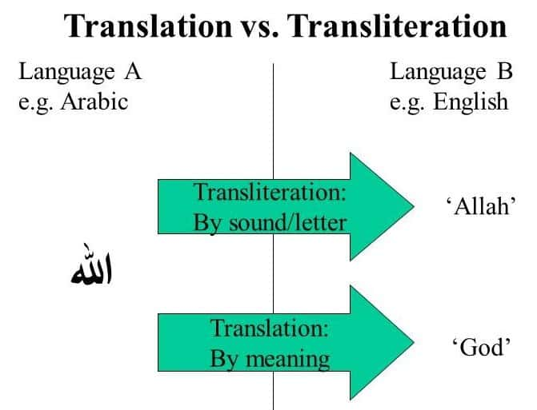

Slide 4
Why keep looking into transliterating?
Standard transliteration systems already exist

Slide 5
Why keep looking into transliterating?
Standard transliteration systems already exist
Many self-transliterate
We are trying to capture this informal transliteration process
Counter-point

Slide 6

A real-life application
Security vetting

Slide 7
The Project Goal
Create a name transliteration pipeline
Raw Twitter Data
Language Model

Slide 8
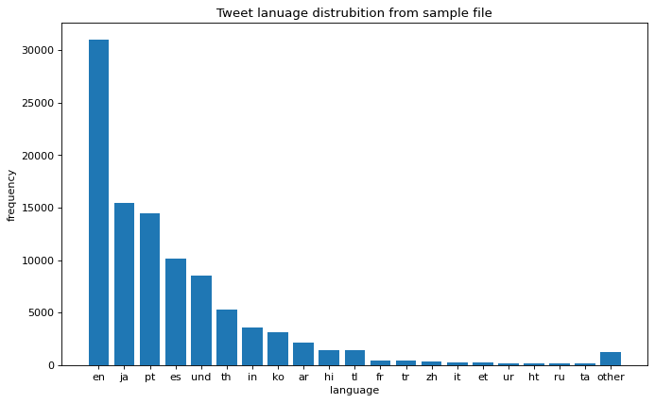
Data Source
Twitter Tweets
Global user space
However, very noisy data
Scope of data
2,00 Twitter files
Each file has 100,000 Tweets
Each Tweet is in JSON format

Slide 9
Methodology – An overview
Filtering
Cleansing
Training
Make into images or something

Slide 10
The Data
{
"created_at":"Thu Mar 11 02:38:06 +0000 2021",
"id":1369840023508455426,
"id_str":"1369840023508455426",
"text":"東日本,
...
"user":{
...
"screen_name":"やさしい靴工房Belle＆Sofa＠うぇ部💛",
"user_name":"BelleSofa",
...
"lang":"ja",
...
}

Slide 11
The Data
{
"created_at":"Thu Mar 11 02:38:06 +0000 2021",
"id":1369840023508455426,
"id_str":"1369840023508455426",
"text":"東日本,
...
"user":{
...
"screen_name":"やさしい靴工房Belle＆Sofa＠うぇ部💛",
"user_name":"BelleSofa",
...
"lang":"ja",
...
}

Slide 12
Filtering – Using Tweet Language
Picture of set of tweets
Arrow (filter on language)
Picture of smaller set of tweets

Slide 13
Filtering
{
"created_at":"Thu Mar 11 02:38:06 +0000 2021",
"id":1369840023508455426,
"id_str":"1369840023508455426",
"text":"東日本,
...
"user":{
...
"screen_name":"やさしい靴工房Belle＆Sofa＠うぇ部💛",
"user_name":"BelleSofa",
...
"lang":"ja",
...
}
A name pair
(BelleSofa,
やさしい靴工房Belle＆Sofa＠うぇ部💛)

Slide 14
Filtering – On screen name
(BelleSofa,
やさしい靴工房Belle＆Sofa＠うぇ部💛)
(BelleSofa,
やさしい靴工房うぇ部)

Slide 15
Cleansing
Name pairs are evaluated
We are only interested in name pairs that are transliterations

Slide 16
Cleansing – Pre-processing of user name
Kanye_WestFan1991

Slide 17
Cleansing – Pre-processing of user name
Kanye_WestFan

Slide 18
Cleansing – Pre-processing of user name
Kanye WestFan

Slide 19
Cleansing – Pre-processing of user name
Kanye West Fan

Slide 20
Cleansing – Pre-processing of user name
kanye west fan

Slide 21
Cleansing – Pre-processing of user name
Kanye_WestFan1991
kanye west fan

Slide 22
Edit-distance
A measure of how similar two words are
How many edits from one word to another
Edits:
Additions
Deletions
Subsititions

Slide 23
Edit-distance Example
To go from “kitten” to “sitting” we need 3 edits
kitten -> sitten
sitten -> sittin
sittin -> sitting
Make into an animation or something?

Slide 24
The modified edit-distance
Use average length of the two words to normalise
Average length of “kitten” and “sitting” is: 6+7/2=7.5
Therefore, modified edit-distance is 3/7.5=0.4

Slide 25
Finding legitimate name pairs
User name
Screen name
For the name pair: (nurato,ナルト)
Screen name
Transliterated screen name
Standard transliteration
ナルト
naruto

Slide 26
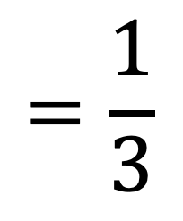
Finding legitimate name pairs
User name
Screen name
For the name pair: (nurato,ナルト)
Screen name
Transliterated screen name
Standard transliteration
ナルト
naruto
(
)
Modified edit distance
$$=\frac{1}{3}$$
If this score is under a threshold.
It is a legitimate name pair
Transliterated screen name
User name
naruto
,
nurato

Slide 27
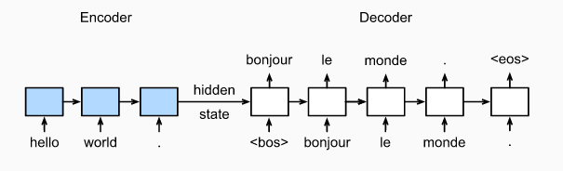
Training – Model Overview
Change to character level instead of word level

Slide 28
Evaluation
3 testing data sets
Each cleansed using different modified edit-distance thresholds
Provides different standards of evaluation

Slide 29
Results
Should note that I was only able to use 536 Twitter files due to hardware limitations
Overall good results based on evaluation

Slide 30

Future Work
Get better hardware to run all 2,000 files
pls buy 4 me

